Slide 1
GLOBAL TERRORISM
DATABASE
Exploratory Data Analysis
1

Slide 2
INTRODUCTION
Terrorism can be broadly understood as a method that utilizes or threatens to utilize violence in order to spread fear and thereby attain political or ideological goals.
Modern terrorism can be traced back to nineteenth century revolutionary radicalism, and the emergence of “anarchist”,
Technological developments in the mid and late nineteenth century also played a pivotal role in the rise of terrorism
We have GTD – global database of terrorism and analyzing to it we can find out the reason and get more relevant information with respect to rise of terrorism.
3

Slide 3
Global Terrorism Database
What is GTD ?
The Global Terrorism Database (GTD)™ is the most comprehensive unclassified database of terrorist attacks in the world.
The GTD is an open-source database, which provides information on domestic and international terrorist attacks around the world since 1970, and now includes more than 200,000 events.
Defining Terrorism
“The threatened or actual use of illegal force and violence by a non-state actor to attain a political, economic, religious, or social goal through fear, coercion, or intimidation.”
4

Slide 4
DATA SUMMARY
event_id
Year
Month
Day
Latitude
Longitude
Deaths
Wounds
Countrty
Region
City
attack_type
target_type
Nationality
Group
Weapon_type
numeric
GLOBAL TERRORISM DATABASE
categorical
binary
Success
Suicide
5

Slide 5
DATA SUMMARY
event_id :- Each attack can be identified by it’s unique id i.e. event_id.
latitude & longitude:- Helps in identifying the exact location of the attack
Deaths & Wounds :- Helps in identifying the total casualty happened in the attack.
6

Slide 6
DATA SUMMARY
Success :- It tells us that whether the terrorist was able to achieve his motive or not.
Suicide :- It tells that if the attack was suicidal.
attack_type :- This gives us information about the type of the attack, i.e. Armed Assault, Assassination, Bombing/Explosion, Facility/Infrastructure Attack, Hijacking, Hostage Taking (Barricade Incident), Hostage Taking (Kidnapping), Unarmed Assault,
7

Slide 7
DATA SUMMARY
Nationality :- It tells the nationality of the target. Suppose there is an attack taking place in USA but on Israel’s embassy then the nationality will be Israel as the target belongs to Israel.
Weapon_type :- The type of the weapon used by the terrorists during the attack, i.e. Explosives, Firearms and Incendiary.
Group :- The associated terrorist group with the attack if identified.
8

Slide 8
DATA CLEANING AND DATA ENGINEERING
The total columns in the data were 135 initially. The columns having null values greater than 70% were removed, in this way total 48 columns were retained rest were removed from the data.
21 columns were found relevant and have been used in the EDA.
Name of the columns used :-
'event_id','Year', 'Month', 'Day', 'extended', 'Country', 'Region', 'City', 'Latitude', 'Longitude', 'Multiple', 'Success', 'Suicide', 'attack_type', 'targt_type', 'Nationolity', 'Group', 'Individual', 'weapon_type', 'Deaths', 'Wounds'
9

Slide 9
EXPLORATORY DATA ANALYSIS
10

Slide 10
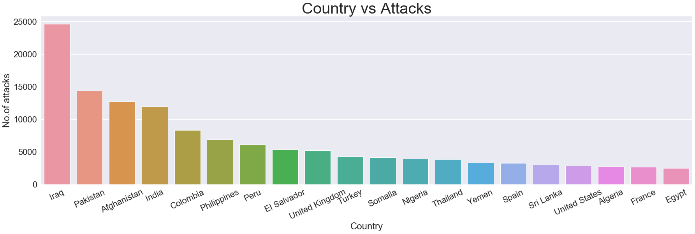
MOST ATTACKED COUNTRIES
The top four most affected countries by terrorism are Iraq, Pakistan, Afghanistan and India.
11

Slide 11
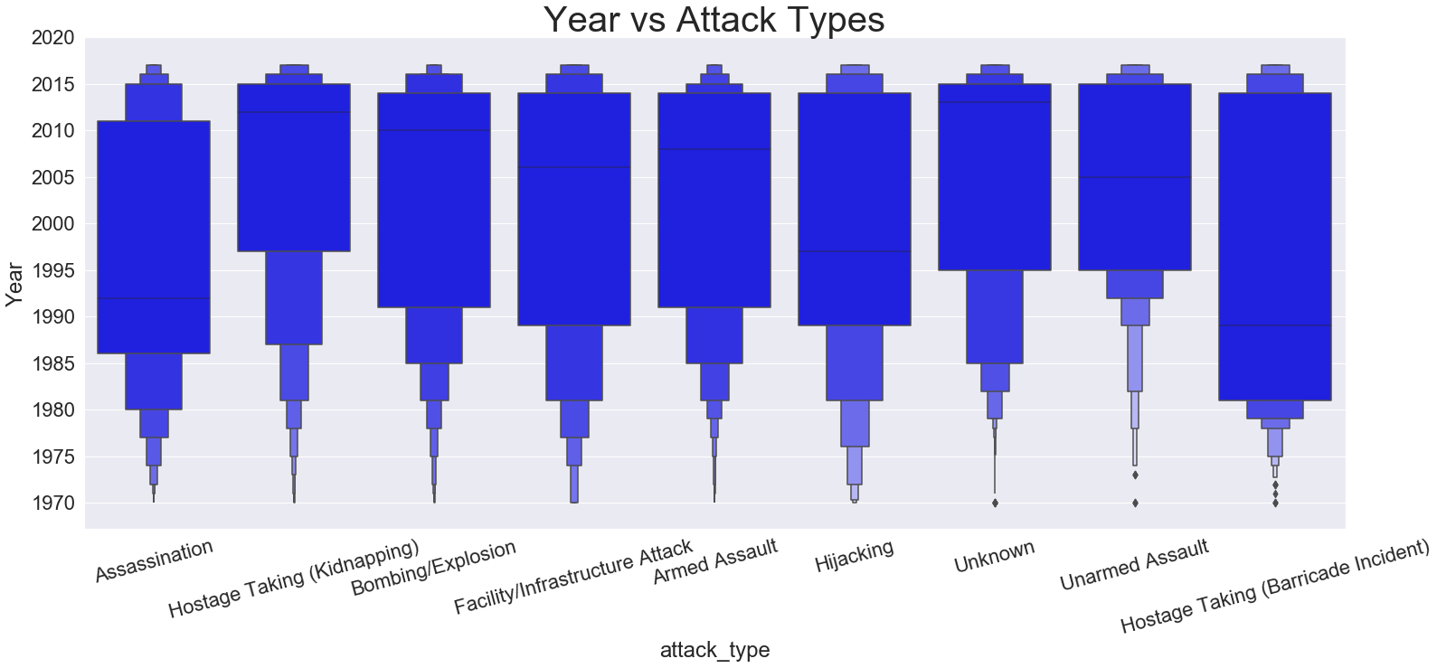
Different types of attacks used by the terrorists over years
Most attacks were of hostage taking(Barricade Incident) and then the attacks for assassination.
12

Slide 12
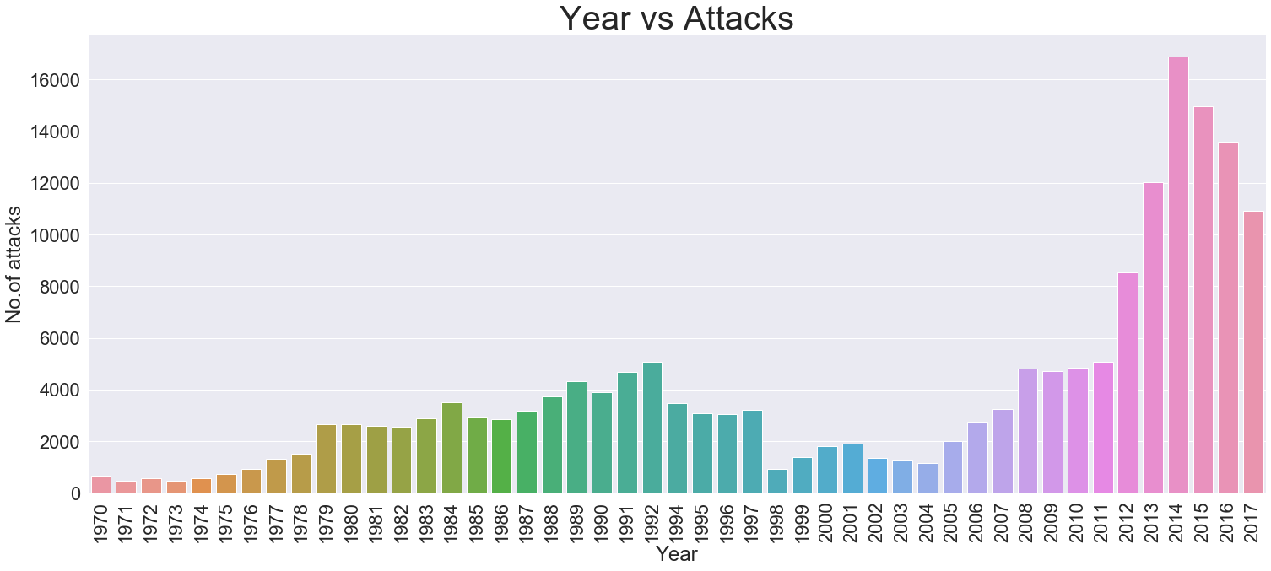
STEEP RISE IN ATTACKS SINCE 2005
The growth of terrorism was at its high during the period of 2005-2014 then after this it started decreasing till the year data is available.
The reason was due to increase in terrorist activities in Iraq, Afghanistan, Pakistan & India.
13

Slide 13
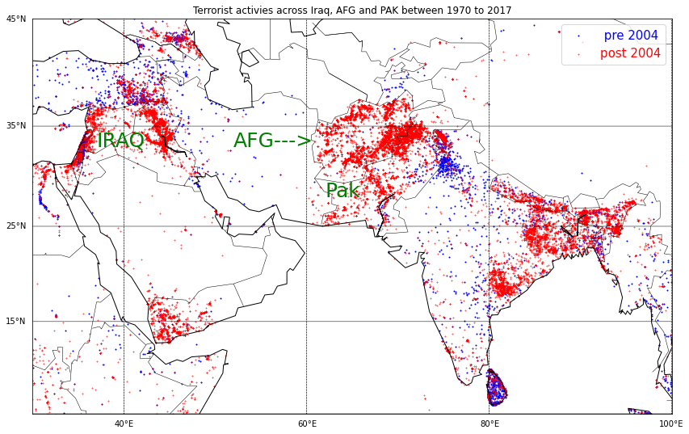
TERRORIST ACTIVITIES IN THE WORLD
The main focus is on the top countries where terrorist activities were seen due to which we can see the steep rise in number of attacks since 2005 over the Globe.
14

Slide 14
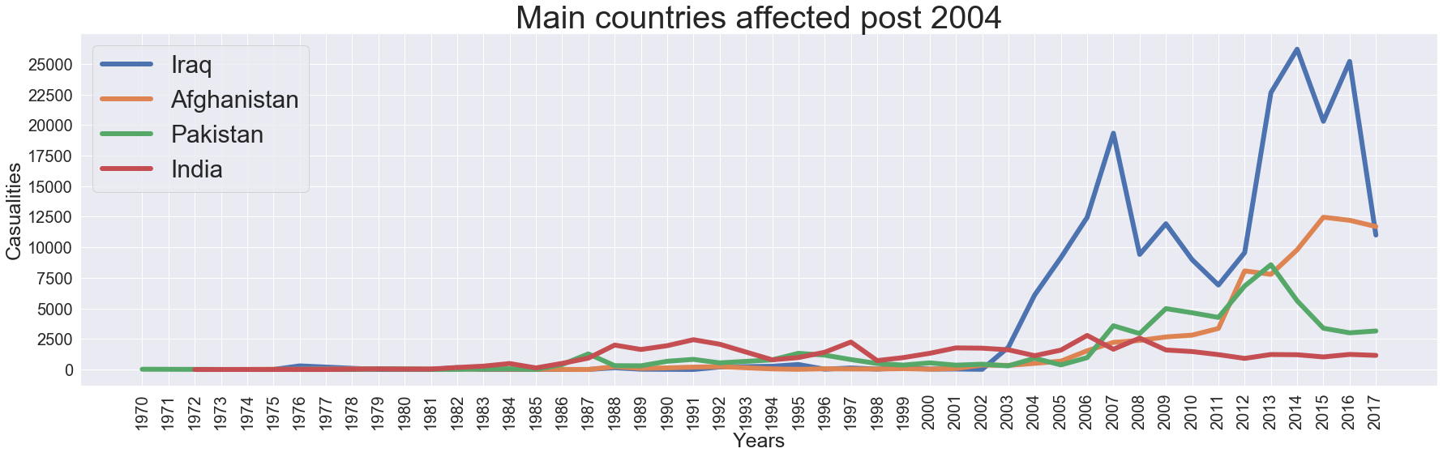
TOP FOUR COUNTRIES AFFECTED BY TERRORISM POST 2004
Most number of people lost their lives in terrorist attacks were from Iraq than Afghanistan than Pakistan than India
15

Slide 15
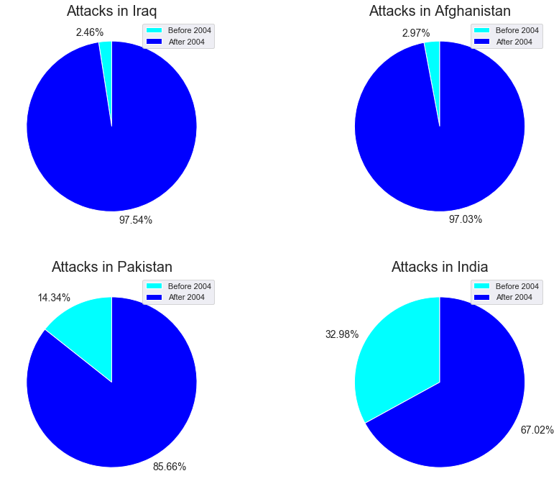
ATTACKS IN TOP FOUR COUNTRIES BEFORE & AFTER 2004
In the countries Iraq, Afghanistan and Pakistan there is a tremendous increase in the attacks after 2004 but in India’s case is not like that, there were attacks in India before 2004 also this means terrorism is a major issue for India since a very long time.
16

Slide 16
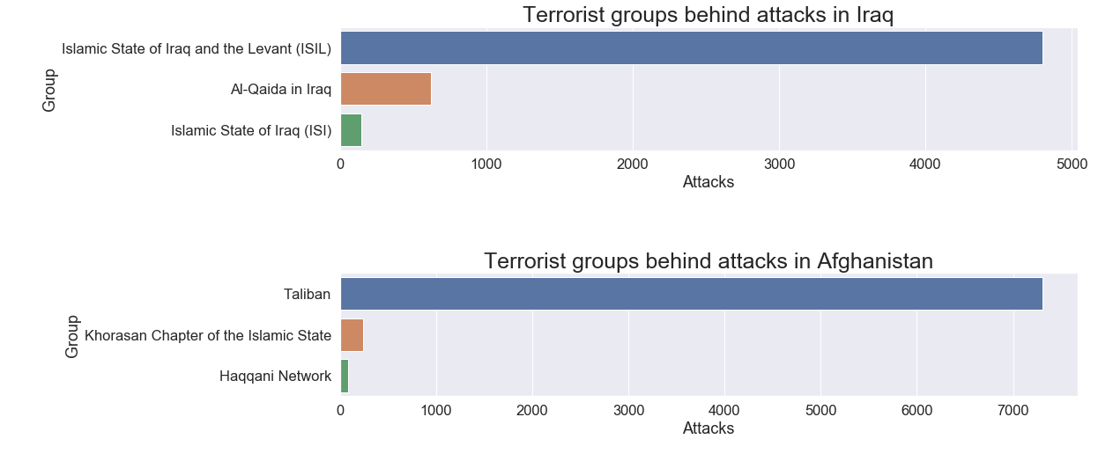
MAJOR TERRORIST GROUPS BEHIND ATTACKS
In Iraq the major terrorist group involved in attacks was Islamic State of Iraq and the Levant(ISIL) this was the time when Islamic State emerged.
At the same time in Afghanistan Taliban emerged as the major terrorist group.
17

Slide 17
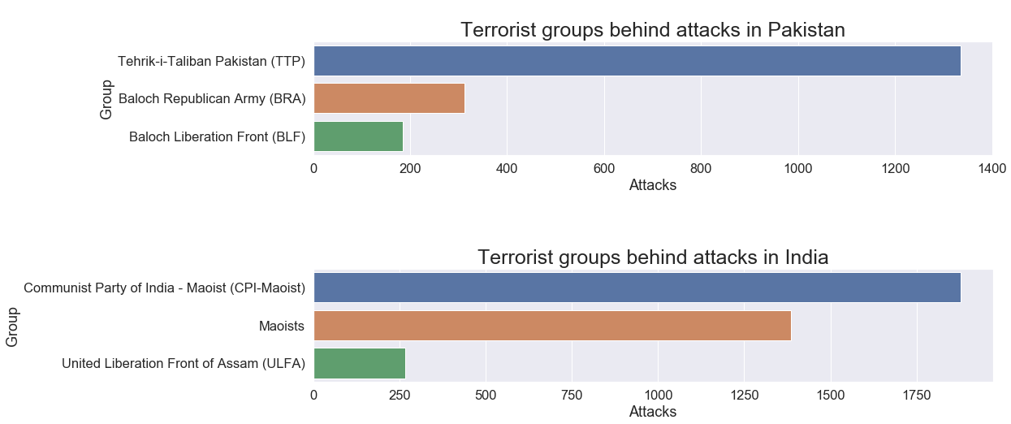
MAJOR TERRORIST GROUPS BEHIND ATTACKS
In Pakistan major terrorist group is Tehrik - i -Taliban Pakistan(TTP).
In India Communist Party of India – Maoist(CPI-M) and Maoists constitutes the most attacks held.
18

